Slide 1
Foundations, Models and Tools
POE372 - Science, Technology, Politics, Society and the Environment (half credit)
POE374 - Science, Technology and Public Policy (full credit)
POE372/374 Week 1

Slide 2
Outline – Week 1
Lecture 1: Overview of the course and how to approach it
Lecture 2: Introduction to useful definitions and concepts, and some overarching questions
Seminar (374 only): How do we explore questions about science, technology, and society? What do you want to learn and how will you use the assignments to do so?
Notes:
In the first week you will get an overview of the course and the key definitions and concepts.
For students in POE374, you will start to map out your written assignments.

Slide 3
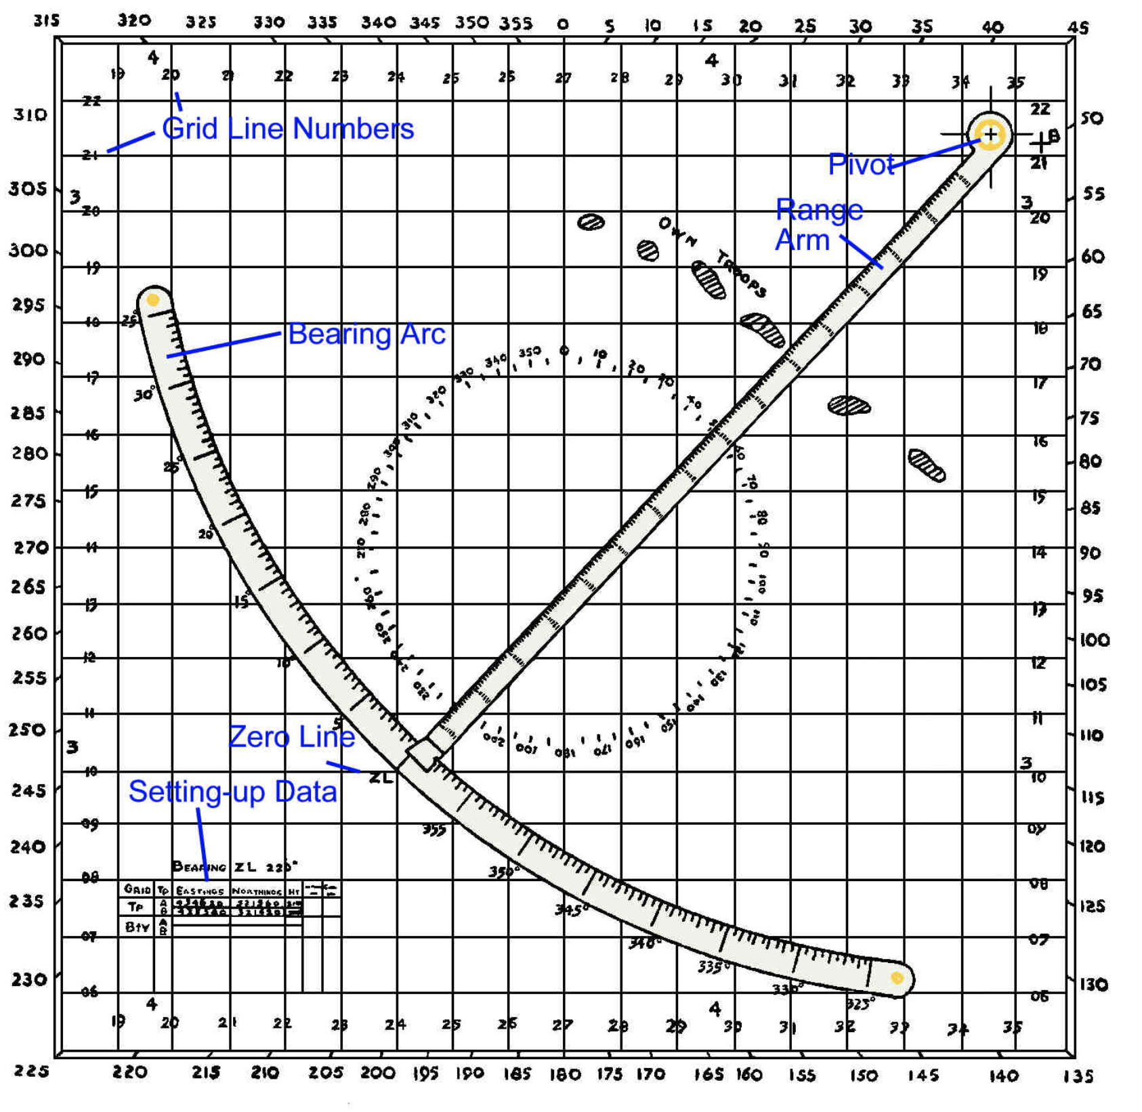

From APGs to Autonomous UAVs and AI
Technology only makes sense as part of a system
Systems change both incrementally and suddenly
Some changes can be reversed, but others cannot
Technology like unmanned airborne vehicles, cruise missiles and artificial intelligence may seem to confer an absolute advantage
Whether it does, depends upon the political, economic, and social systems within which technology is embedded
Artillery Plotting Graph (APG) still in use in 1975 in 30 RCA(M), Ottawa
Notes:
I joined the reserves in 1975 at Dows’ Lake Armoury in Ottawa, two years before I transferred to the Regular Force and attended Royal Roads Military College.
The 30th Field Regiment, Royal Canadian Artillery was equipped with 105mm C1 Howitzers. In its stores it still had 1901 pattern mule harnesses which had been used in the Boer War.
My first technical training was on the Artillery Plotting Graph – a square of plywood with gridded plastic “talc” and a range-arm pinned to the corner. We were still using APGs as safety officers on the M109 gunline in Germany in 1985. They had the advantage of allowing the officer to see the application of the data and serve as a visual double check on the computer data.
Individual pieces of technology, like the APG, the C1 Howitzer, and even the moldy old mule harnesses only make sense as part of complex political, economic, and social systems, within which the use of armed force is seldom at centre stage.
This is the kind of problem we will try to understand over the four modules of this course.

Slide 4
Course Overview
Week 1, Lecture 1

Slide 5
Science and Tech in Social Context
POE372 for Engineers
“An ability to analyze social and environmental aspects of engineering activities. Such ability includes an understanding of the interactions that engineering has with the economic, social, health, safety, legal, and cultural aspects of society, the uncertainties in the prediction of such interactions; and the concepts of sustainable design and development and environmental stewardship.”
Canadian Engineering Accreditation Board, A Guide to Outcomes Based Criteria for Visiting Team Chairs and Program Visitors, Version 1.25, March 2015, p. 23.
POE374 for any student
POE374 fits in the field of public administration or the stream “Canada”. The three modules of the course address elements of human security, national security, and international security and are suitable as an elective course with military content for students in Military and Strategic Studies.
Policy is “what should be done” but it is built on evidence and assumptions about cause and effect: why do these problems exist and what should be done about them?

Slide 6
Politics, Policy, and Environment
The unifying theme of the course is way in which science and technology interact with politics, society, and the environment
We are exploring political, economic, and social systems
Politics is about power, economics is about livelihoods, and social systems are about how people live together (we’ll look at definitions more closely)
We can’t understand any of these systems in isolation, so each of the modules tries to take a holistic perspective with a different aspect in the foreground

Slide 7
What’s in the foreground?
Module 1: politics and policy are in the foreground. Politics is the process of deciding who gets what, when, and how (Lasswell, 1936) and policy represents decisions about what is to be done. How do governments make policy about science and technology, and what are the relative merits of planning and free markets for generating innovation. These themes recur.
Module 2: the economy and the environment are in the foreground. We focus on growth, systems characteristics, and policies for resilience and change.
Module 3: society and employment are in the foreground. Technology impacts employment and questions of markets and innovation recur.
Module 4: we put defence technology in the foreground and look Canadian practices of procurement and industrial development. This brings us back to politics and policies discussed in Module 1.

Slide 8
Module 1: Models and Tools
Week 2 - Policy
How governments make decisions about science and technology: committees, courtiers, and bureaucracies (C.P. Snow) and all you really need to know summarized in five diagrams
What is Evidence-based policy, and how do we approach it realistically? (R. Pawson)
Week 3 – Innovation I
What are the relative strengths of government plans and free markets as ways to advance science and technology?
Canada’s innovation strategy: asleep at the switch?
Week 4 – Markets
Ottawa’s policy ‘marketplace’ and how decisions are made
How policies are influenced

Slide 9
Module 1 seminars
Seminars are the third period each week. They are mandatory for students in POE374, but optional for students in POE372.
Week 2: How is science policy made in Canada?
Week 3: What do we need to know to understand an evaluate an innovation policy?
Week 4: Questions for lobbyists and influencers in Ottawa.

Slide 10
Module 2: Environment and Growth
Week 5: Growth
A short economic history of the world – hockey-stick growth
Carbon economies and carbon consequences – are we doomed?
Week 6: Systems
Systems thinking, its implications and practical limits
Change, resilience, bouncing back and bouncing forward
Week 7: Designing for resilience
Is slower by design possible?
New technologies for survival and growth; policies and resistance

Slide 11
Module 2 Seminars
Week 5: Growth and climate change as a policy problem – how do governments balance long-term and short-term imperatives?
Week 6: Planning for resilience – how do governments manage risks and potential disasters?
Week 7: Is slower by design possible? Who benefits and who suffers? What accommodations are implied between public sector, private sector, and volunteer sector?

Slide 12
Module 3: Society and Employment
Week 8: Capitalism as an organizing principle
How technology affects employment – for good and ill
Surveillance capitalism - the next era of neoliberal globalization
Week 9: Ubiquitous markets and dubious regulation
Polices and markets for generating employment and wealth
Foreign ownership, control and investment
Week 10: Innovation
Technology clusters, innovation and diffusion policies
Capital accumulation, technology and new jobs

Slide 13
Module 3 Seminars
Week 8: A debate on government job creation programs – technology, investment and employment
Week 9: Risk analysis – intellectual property, sovereign looting and product mandate shift in a global economy
Week 10: Debate – is big capital an ally or enemy for government technology and employment programs?

Slide 14
Module 4: Defence and Procurement
Week 11: How defence procurement works
Government of Canada procurement structure
Cubicle warrior strategies in public administration
Week 12: Canada’s National Shipbuilding Strategy
Naval technology and shipbuilding problems
The National Shipbuilding Strategy
Week 13: Aircraft procurement and national technological base
Aircraft technology and intellectual property
Missile Technology Control Regime and the next generation fighter

Slide 15
Module 4 Seminars
Week 11: Gaming procurement – how are requirements sold to different stakeholders?
Week 12: trade-offs between operational capabilities and industrial benefits – an analytical hierarchy process
Week 13: trade-offs between integration and independence in aviation technology – an analytical hierarchy process

Slide 16
Recurring themes
How are decisions about made about science and technology and who makes them? How do public and private sector interests cooperate or compete?
What are the roles of markets, planning and regulation in pursuing collective goals for growth, employment, sustainability, and security?
What are your responsibilities as public servants and citizens in managing science and technology?

Slide 17
Conclusion – an interconnected system?
Politics and Policy
Defence and procurement
Economics and environment
Society and employment
Notes:
Your challenge as the course progresses is to trace the connections between politics, policy, economics, the environment, society, employment, and defence and security. How are these related to science and technology, innovation, markets, and the resilience of the systems on which we rely for human security and national security? The problem-solving essays in the final exam (for 372) and your written assignments (in 374) are judged on your ability to draw the connections between these major elements of the course.

